Slide 1
ChatOps and Bots with PowerShell
Steve Lee PowerShell Team
Notes:
This is the slide shown before the presentation starts. When you are ready to go, tell the video operator to start the recording, and click to the next slide.

Slide 2
5
Video operator, did you start the recording?
Notes:
[REQUIRED SLIDE]
These slides are mandatory and help us with video post-processing. Please keep them as they are.

Slide 3
4
Notes:
[REQUIRED SLIDE]

Slide 4
3
Notes:
[REQUIRED SLIDE]

Slide 5
2
Notes:
[REQUIRED SLIDE]

Slide 6
1
Notes:
[REQUIRED SLIDE]

Slide 7
ChatOps and Bots with PowerShell
Steve Lee PowerShell Team
Notes:
This is your opening. Now the stage is yours!

Slide 8
This Session
You will understand why you should leverage ChatOps and Bots and how to build it using PowerShell
Notes:
Please invest some time to reconsider your session: what is it that audience can get out of it? Try and be as precise as you can. If you are showing solutions, then focus on “how to”. If you present about a general technology, you’ll want to stick to “Be able to” or “Understand why/how”.

Slide 9
Agenda
$ChatOps + $Bots + $Serverless | Should –Exist
$bot = $PowerShell + $AzFunctions + $Teams
$PoshChanBot = Receive-GitHub | Invoke-AzDevOps | Out-GitHub
Start-Questions | Get-Answers

Slide 10
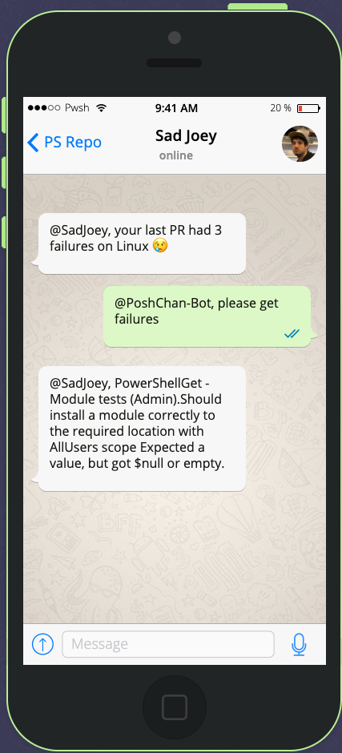
What is ChatOps?
Conversation driven operations
Interactive automation
Visibility to aid training and collaboration

Slide 11

What are Bots?
Application that receives requests, execute tasks, and return results
Bot frameworks
https://dev.botframework.com/
https://hubot.github.com/

Slide 12
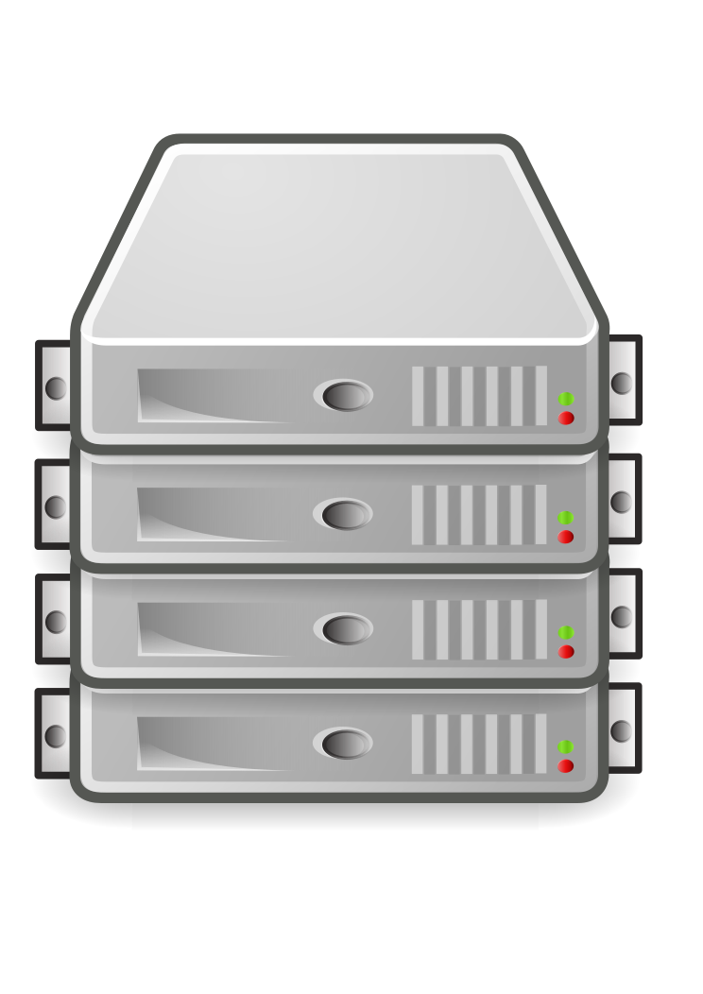
What is Serverless?
No server to manage
Pay for what you use (idling is free)
Flexible scaling

Slide 13

Why not serverless for everything?
Ephemeral (short lived)
Idempotent (safe to rerun)
Reactive (event triggered)
Stateless (stored elsewhere)
Asynchronous (concurrency)

Slide 14

Why choose serverless?
Easy to get started
Inexpensive to run
Focus on application and not managing server/container

Slide 15
PowerShell Scripter -> Serverless Developer
Leverage existing PowerShell scripting experience
Start with simple scenarios that make sense in the cloud

Slide 16
Build-a-Bot
Notes:
$status = [HttpStatusCode]::OK
$body = @{
type = "message"
text = $Request.Body | ConvertTo-Json
}
$text = [System.Web.HttpUtility]::HtmlDecode($Request.Body.text)
Write-Host "Text: '$text'"
if ($text -match "<at>.*?</at> (?<command>.*?)\n") {
$command = $matches.command
Write-Host "Command: '$command'"
$response = @"
``````
$(Invoke-Expression $command | Out-String)
``````
"@
}
else {
$response = "Did not receive a proper command"
}
$status = [HttpStatusCode]::OK
$body = @{
type = "message"
text = $response
}

Slide 17

Now something a bit more complex…
Authorization
Configuration
Multi-step tasks
Concurrency
Leveraging other cloud
services

Slide 18
Basic ChatBot design
Mobile
Client (Teams, Slack, …)
REST API
Bot
REST API Action
Desktop
Web

Slide 19
Detailed Design
Task A
REST API Task
Client
REST API Bot
Storage Queue
Task B
REST API Task
Task C
REST API Task

Slide 20

PoshChan-Bot
https://github.com/SteveL-MSFT/PoshChan-Bot
Triggered by conversations/events on GitHub
Takes actions against GitHub or Azure DevOps Pipelines
Capabilities
Rebuild or retry an Azure DevOps Pipeline
Automatically fetch and post summary of Pull Request test failures
Custom reminder

Slide 21
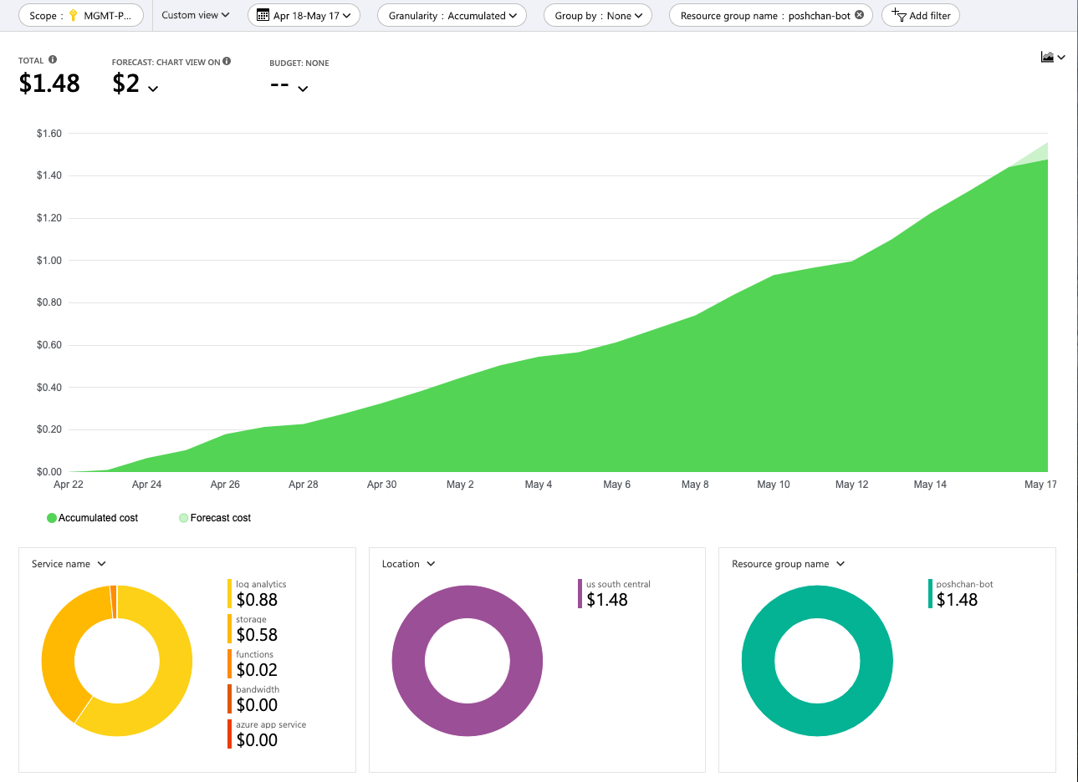

Slide 22
PoshChan-Bot and GitHub

Slide 23


PoshChan-Bot Architecture Client-Side
GitHub Issue Comment
GitHub Repository Webhooks
PoshChan-Bot REST API
GitHub Status Event

Slide 24
PoshChan-Bot Architecture ServerLess-Side
@PoshChan, please retry linux

Slide 25

PoshChan-Bot Architecture ServerLess-Side
PoshChan-Bot run.ps1
AzFunction
HTTP Trigger
@PoshChan, please retry linux

Slide 26
PoshChan-Bot Architecture ServerLess-Side
PoshChan module
PoshChan-Bot run.ps1
AzFunction
HTTP Trigger
@PoshChan, please retry linux

Slide 27
PoshChan-Bot Architecture ServerLess-Side
.poshchan/ settings.json
PoshChan module
PoshChan-Bot run.ps1
AzFunction
HTTP Trigger
@PoshChan, please retry linux

Slide 28
PoshChan-Bot Architecture ServerLess-Side
.poshchan/ settings.json
PoshChan module
PoshChan-Bot run.ps1
AzFunction
AzureHelpers module
HTTP Trigger
@PoshChan, please retry linux

Slide 29
PoshChan-Bot Architecture ServerLess-Side
.poshchan/ settings.json
PoshChan module
PoshChan-Bot run.ps1
AzFunction
AzureHelpers module
AzureStorage module
HTTP Trigger
@PoshChan, please retry linux

Slide 30

PoshChan-Bot Architecture ServerLess-Side
.poshchan/ settings.json
azdevops-rebuild
queue
PoshChan module
PoshChan-Bot run.ps1
AzFunction
AzureHelpers module
AzureStorage module
HTTP Trigger
@PoshChan, please retry linux

Slide 31
PoshChan-Bot Architecture ServerLess-Side
azdevops-rebuild
queue
AzDevOps-Rebuild
AzFunction

Slide 32
PoshChan-Bot Architecture ServerLess-Side
azdevops-rebuild
queue
AzDevOps-Rebuild
AzFunction
AzDevOps module
AzDevOps

Slide 33
PoshChan-Bot Architecture ServerLess-Side
azdevops-rebuild
queue
AzDevOps-Rebuild
AzFunction
AzDevOps module
AzDevOps
github-respond
queue

Slide 34
PoshChan-Bot Architecture ServerLess-Side
github-respond
queue
GitHub-Respond
AzFunction

Slide 35
PoshChan-Bot Architecture ServerLess-Side
github-respond
queue
GitHub-Respond
AzFunction
GitHub module
GitHub

Slide 36
PoshChan-Bot Architecture ServerLess-Side
.poshchan/ settings.json
azdevops-rebuild
queue
AzDevOps-Rebuild
AzFunction
PoshChan module
AzDevOps module
AzDevOps
PoshChan-Bot run.ps1
AzFunction
AzureHelpers module
AzureStorage module
github-respond
queue
GitHub-Respond
AzFunction
GitHub module
GitHub
HTTP Trigger
@PoshChan, please retry linux

Slide 37
Dive into the code

Slide 38
Summary
Build serverless applications using PowerShell
Leverage Bots and ChatOps to be more productive
JSON and HTTP is easy with PowerShell
Notes:
Sum up your key messages

Slide 39
Notes:
[REQUIRED SLIDE]
Make sure you provide all materials that audience needs to reproduce your demos.
Either upload them as a PowerShell module to www.powershellgallery.com (preferred for reusable functions)
Or, upload them to our github repository (ask the girls at the info desk to provide you with access)
Or, upload them to your own github repository
Please make sure all materials are available by the time your presentation starts, or at minimum upload them right after your presentation

Slide 40
Notes:
[REQUIRED SLIDE]
If you sticked to your timing, you now have 15 min left for Q&A. If you missed your timing, you will have to leave the room when your slot is over. In this case, invite your audience to the coffee break and offer to cover questions there.
IN ANY CASE please point your audience to the conference app and the session voting. By the time the conference opens, the eventraft app *should* have the option to vote on sessions.
Please MAKE SURE you leave your room when your slot is over. The next speaker would like to set him/herself up and get everything up and running.

Slide 41
about_Speaker
Software Engineering Manager for the PowerShell Core team of 8 engineers owning:
Windows PowerShell
PowerShell Core/PowerShell 7
PSReadLine
PSScriptAnalzyer
PSEditorServices/VSCode-Extension
Recently took ownership of PowerShellGallery, PkgMgmt, PSGet
Recently took back ownership of OpenSSH
Notes:
Do not EVER discuss this slide during your presentation. Please do not take presentation time to talk about yourself more than just a few introductory sentences. Instead, invite interested audience to the coffee break, and then talk about yourself, your job, your services, etc.
Use this slide to sum up your details. It will be part of the conference materials and recorded videos.

